Slide 1

Unit 2
Spatial Filtering
Smoothening and Sharpening

Slide 2
Spatial filtering techniques
Linear smoothening filter
Nonlinear
Sharpening filter

Slide 3
Linear smoothening filter
Box filter and weighted average filter

Slide 4
Box filter: spatial filter in which all coefficients are equal
Weighted average: pixels are multiplied by different values
Weights given to pixels is different
Pixel at the centre given more weight
Other pixels are inversely weighted as a function of their distance from the centre of the mask
Diagonal elements weighted less.
This is done to reduce the blurring in the smoothening process
Application: Used for noise reduction
Random noise typically consists of sharp transitions in intensity levels
Disadvantage: Blurs the edges
Edges are also characterized by sharp intensity transitions

Slide 5

Mean Filters
Same as box filter
$f^{′}\left(x,y\right)=\frac{1}{mn}\sum_{(r,c)∈s_{xy}}{g(r,c)}$
Geometric mean filter
$f^{′}\left(x,y\right)=\prod_{(r,c)∈s_{xy}}{g(r,c)}$ ^ $\frac{1}{mn}$
Each resultant pixel is the product of all pixels in the nighbourhood to the power of 1/mn
Achieves smoothening comparable to average filter
Less image details lost

Slide 6
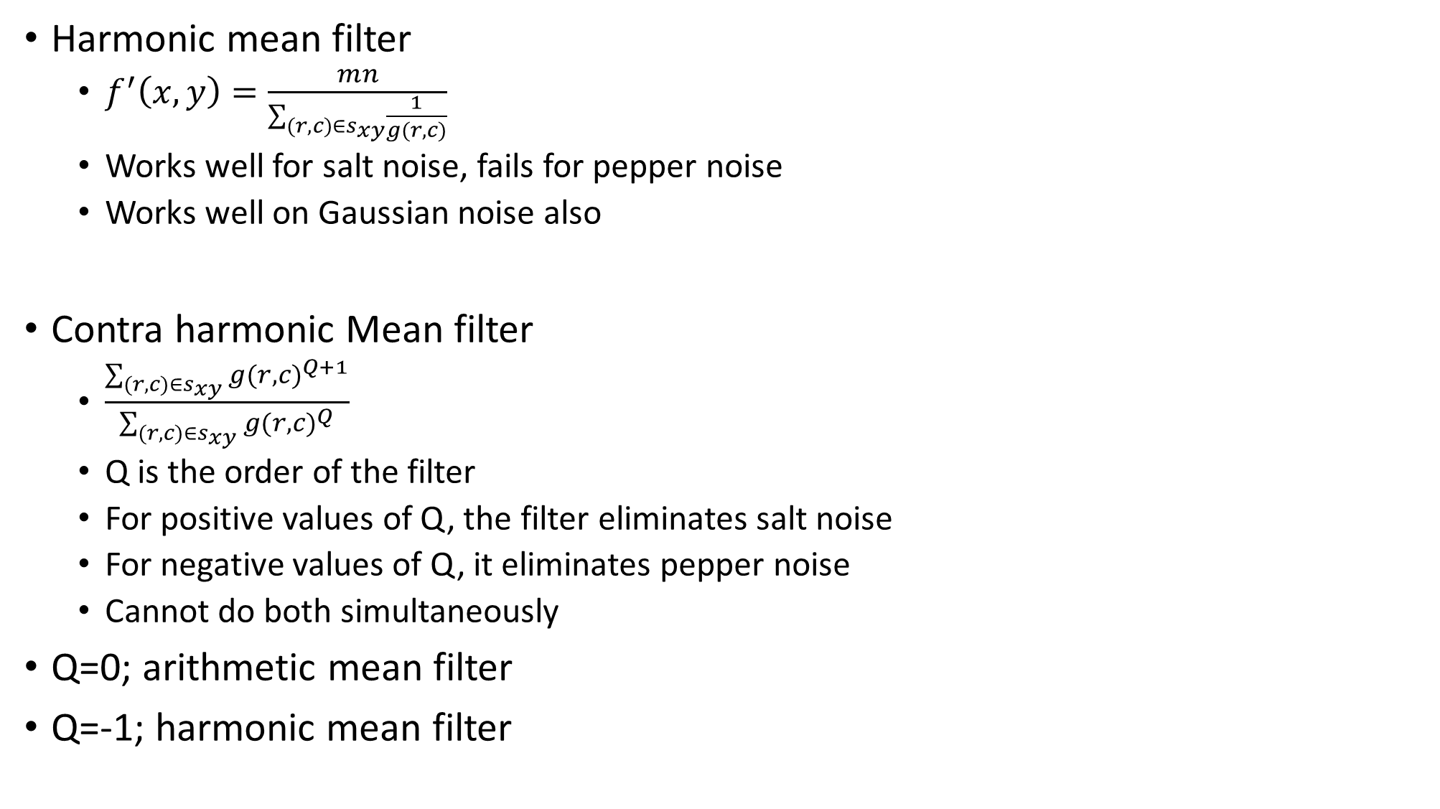
Harmonic mean filter
$f^{′}\left(x,y\right)=\frac{mn}{\sum_{(r,c)∈s_{xy}}{\frac{1}{g(r,c)}}}$
Works well for salt noise, fails for pepper noise
Works well on Gaussian noise also
Contra harmonic Mean filter
$\frac{\sum_{(r,c)∈s_{xy}}{{g(r,c)}^{Q+1}}}{\sum_{(r,c)∈s_{xy}}{{g(r,c)}^{Q}}}$
Q is the order of the filter
For positive values of Q, the filter eliminates salt noise
For negative values of Q, it eliminates pepper noise
Cannot do both simultaneously
Q=0; arithmetic mean filter
Q=-1; harmonic mean filter

Slide 7
Non linear filters (Order statistic Filters)
Median filter
Value of a pixel replaced by the median values of its neighbours
Half the values will be above median and half will be below median
Forces the points with distinct intensity values to be more like their neighbours
Reduces noise, especially salt and pepper noise

Slide 8
Median filter example
3 | 9 | 4 | 52 | 3 | 8 | 6 | 2 | 2 | 9
By extending border
3 | 3 | 9 | 4 | 52 | 3 | 8 | 6 | 2 | 2 | 9 | 9
3 | 4 | 9 | 4 | 8 | 6 | 6 | 2 | 2 | 9
By Zero padding
0 | 3 | 9 | 4 | 52 | 3 | 8 | 6 | 2 | 2 | 9 | 0
3 | 4 | 9 | 4 | 8 | 6 | 6 | 2 | 2 | 9

Slide 9
1 | 4 | 0 | 1 | 3 | 1
2 | 2 | 4 | 2 | 2 | 3
1 | 0 | 1 | 0 | 1 | 0
1 | 2 | 1 | 0 | 2 | 2
2 | 5 | 3 | 1 | 2 | 5
1 | 1 | 4 | 2 | 3 | 0

Slide 10
1 | 4 | 0 | 1 | 3 | 1
2 | 2 | 4 | 2 | 2 | 3
1 | 0 | 1 | 0 | 1 | 0
1 | 2 | 1 | 0 | 2 | 2
2 | 5 | 3 | 1 | 2 | 5
1 | 1 | 4 | 2 | 3 | 0
1 | 1 | 4 | 0 | 1 | 3 | 1 | 1
1 | 1 | 4 | 0 | 1 | 3 | 1 | 1
2 | 2 | 2 | 4 | 2 | 2 | 3 | 3
1 | 1 | 0 | 1 | 0 | 1 | 0 | 0
1 | 1 | 2 | 1 | 0 | 2 | 2 | 2
2 | 2 | 5 | 3 | 1 | 2 | 5 | 5
1 | 1 | 1 | 4 | 2 | 3 | 0 | 0
1 | 1 | 1 | 4 | 2 | 3 | 0 | 0
2 | 2 | 2 | 2 | 2 | 2
1 | 1 | 1 | 1 | 1 | 1
1 | 1 | 1 | 1 | 2 | 2
1 | 1 | 1 | 1 | 1 | 2
1 | 2 | 2 | 2 | 2 | 2
1 | 2 | 2 | 3 | 2 | 2

Slide 11
1 | 4 | 0 | 1 | 3 | 1
2 | 2 | 4 | 2 | 2 | 3
1 | 0 | 1 | 0 | 1 | 0
1 | 2 | 1 | 0 | 2 | 2
2 | 5 | 3 | 1 | 2 | 5
1 | 1 | 4 | 2 | 3 | 0
0 | 0 | 0 | 0 | 0 | 0 | 0 | 0
0 | 1 | 4 | 0 | 1 | 3 | 1 | 0
0 | 2 | 2 | 4 | 2 | 2 | 3 | 0
0 | 1 | 0 | 1 | 0 | 1 | 0 | 0
0 | 1 | 2 | 1 | 0 | 2 | 2 | 0
0 | 2 | 5 | 3 | 1 | 2 | 5 | 0
0 | 1 | 1 | 4 | 2 | 3 | 0 | 0
0 | 0 | 0 | 0 | 0 | 0 | 0 | 0
0 | 2 | 1 | 1 | 1 | 0
0 | 1 | 1 | 1 | 1 | 1
0 | 1 | 1 | 1 | 2 | 1
0 | 1 | 1 | 1 | 1 | 1
1 | 2 | 2 | 2 | 2 | 2
0 | 1 | 1 | 1 | 1 | 0

Slide 12

Non linear filters (Order statistic Filters)
Max filter
R= max{$z_{k}|k=1,2,3..9\}$
Min filter
R= min$\{z_{k}|k=1,2,3..9\}$

Slide 13
Max filter example
3 | 9 | 4 | 52 | 3 | 8 | 6 | 2 | 2 | 9
By extending border
3 | 3 | 9 | 4 | 52 | 3 | 8 | 6 | 2 | 2 | 9 | 9
9 | 9
By Zero padding
0 | 3 | 9 | 4 | 52 | 3 | 8 | 6 | 2 | 2 | 9 | 0

Slide 14
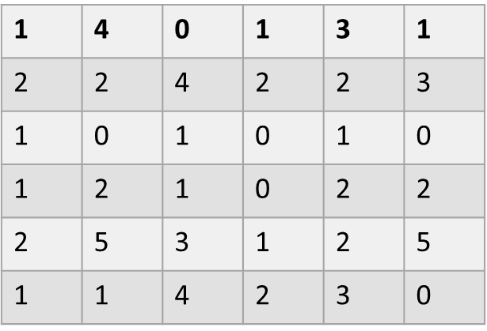
1 | 1 | 4 | 0 | 1 | 3 | 1 | 1
1 | 1 | 4 | 0 | 1 | 3 | 1 | 1
2 | 2 | 2 | 4 | 2 | 2 | 3 | 3
1 | 1 | 0 | 1 | 0 | 1 | 0 | 0
1 | 1 | 2 | 1 | 0 | 2 | 2 | 2
2 | 2 | 5 | 3 | 1 | 2 | 5 | 5
1 | 1 | 1 | 4 | 2 | 3 | 0 | 0
1 | 1 | 1 | 4 | 2 | 3 | 0 | 0
4 | 4 | 4 | 4 | 3 | 3
4 | 4 | 4 | 4 | 3 | 3
2 | 4 | 4 | 4 | 3 | 3
5 | 5 | 5 | 3 | 5 | 5
5 | 4 | 5 | 4 | 5 | 5
5 | 5 | 5 | 4 | 5 | 5
1 | 0 | 0 | 0 | 1 | 1
0 | 0 | 0 | 0 | 0 | 0
0 | 1 | 0 | 0 | 0 | 0
0 | 0 | 0 | 0 | 0 | 0
1 | 1 | 0 | 0 | 0 | 0
1 | 1 | 1 | 1 | 0 | 0

Slide 15
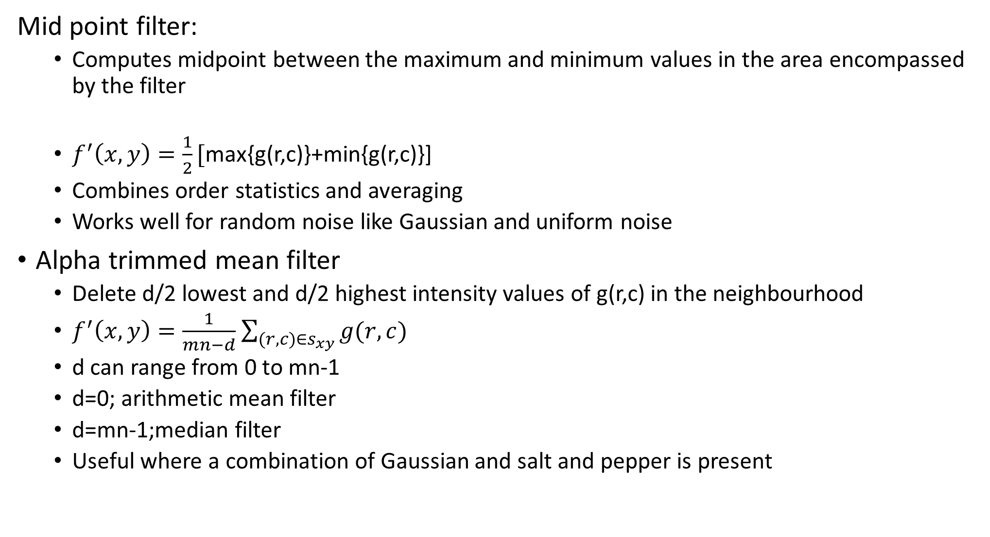
Mid point filter:
Computes midpoint between the maximum and minimum values in the area encompassed by the filter
$f^{′}\left(x,y\right)=\frac{1}{2}[$max{g(r,c)}+min{g(r,c)}]
Combines order statistics and averaging
Works well for random noise like Gaussian and uniform noise
Alpha trimmed mean filter
Delete d/2 lowest and d/2 highest intensity values of g(r,c) in the neighbourhood
$f^{′}\left(x,y\right)=\frac{1}{mn−d}$ $\sum_{(r,c)∈s_{xy}}{g(r,c)}$
d can range from 0 to mn-1
d=0; arithmetic mean filter
d=mn-1;median filter
Useful where a combination of Gaussian and salt and pepper is present

Slide 16
Apply the following filters on the image below and calculate the pixel
value at (2,2). Smoothening is done in a 3x3 neighbourhood
Box filter
Weighted average
Median filter
Max filter
Min filter
Mid point
Geometric
Harmonic
7 | 9 | 5
4 | 6 | 8
2 | 0 | 1

Slide 17
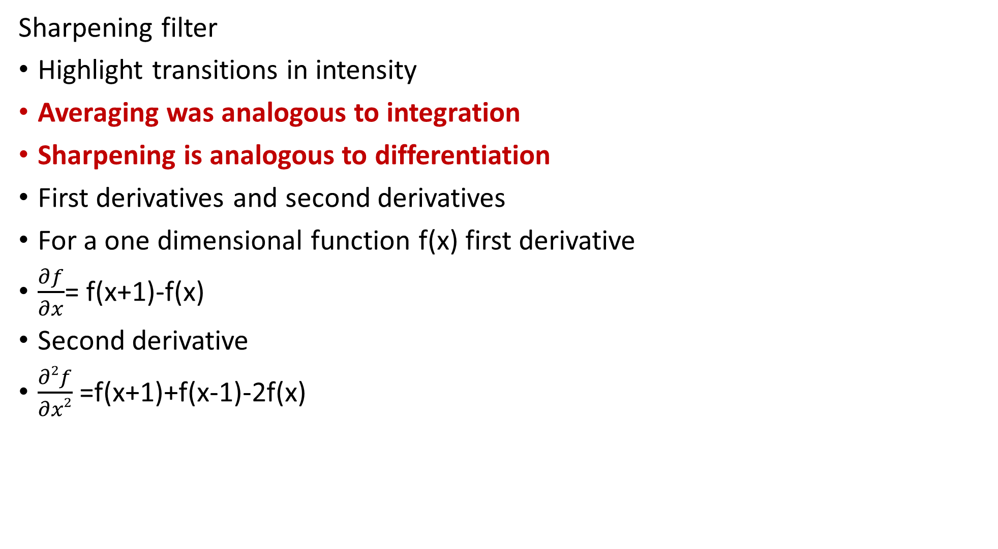
Sharpening filter
Highlight transitions in intensity
Averaging was analogous to integration
Sharpening is analogous to differentiation
First derivatives and second derivatives
For a one dimensional function f(x) first derivative
$\frac{∂f}{∂x}$= f(x+1)-f(x)
Second derivative
$\frac{∂2f}{∂x2}$ =f(x+1)+f(x-1)-2f(x)

Slide 18
First order derivatives:
Must be zero in areas of constant intensity
Must be nonzero at the onset of an intensity step or ramp
Must be nonzero along intensity ramps
Second order derivatives:
Must be zero in areas of constant intensity
Must be nonzero at the onset and end of an intensity step or ramp
Must be zero along intensity ramps

Slide 20
Effects of first order and second order derivative filter
First order:
Must be zero in the areas of constant gray level
Non-zero at the onset of a gray level step or ramp
Non-zero along the ramps
Second order:
Zero in the flat areas
Non-zero at onset and end of a gray level step or ramp
Zero along ramp of constant slope

Slide 21
Comparison of first order and second order derivatives
First order derivatives generally produce thicker edges in an image
Second order derivatives give stronger response to fine details such as thin lines and isolated points
First order derivatives have stronger response to gray level step
Second order derivatives produce a double response at step edges
Second order derivatives are better suited for image enhancement

Slide 22

(Laplacian filter)
Second derivative filter for image sharpening
One Dimensional
$\frac{∂2f}{∂x2}$ =f(x+1)+f(x-1)-2f(x)
Two dimensional
$\frac{∂2f}{∂x2}$ =f(x+1,y)+f(x-1,y)-2f(x,y)
$\frac{∂2f}{∂y2}$ =f(x,y+1)+f(x,y-1)-2f(x,y)
Laplacian = $\frac{∂2f}{∂x2}$+ $\frac{∂2f}{∂y2}$=
Can be calculated using the convolution filter

Slide 23
 | f (x-1, y)
f (x, y-1) | f (x, y) | f (x, y+1)
 | f (x+1, y)

Slide 24
Variants of Laplacian
0 | 1 | 0
1 | -4 | 1
0 | 1 | 0
0 | -1 | 0
-1 | 4 | -1
0 | -1 | 0
1 | 1 | 1
1 | -8 | 1
1 | 1 | 1
-1 | -1 | -1
-1 | 8 | -1
-1 | -1 | -1
Sum of pixel values always equal to 0

Slide 25
Enhanced Laplacian
0 | 1 | 0
1 | -4 | 1
0 | 1 | 0
0 | 1 | 0
1 | -5 | 1
0 | 1 | 0
1 | 1 | 1
1 | -8 | 1
1 | 1 | 1
1 | 1 | 1
1 | -9 | 1
1 | 1 | 1
Sum of pixel values always equal to 0

Slide 26
Apply Laplacian and enhanced Laplacian filter on the image below and calculate the pixel value at (2,2). Sharpening is done in a 3x3
neighbourhood
7 | 9 | 5
4 | 6 | 8
2 | 0 | 1

Slide 27
Apply Laplacian filter on the image given below. 3x3 neighbourhood is
considered
50 | 50 | 50 | 100 | 100 | 100
50 | 50 | 50 | 100 | 100 | 100
50 | 50 | 50 | 100 | 100 | 100
100 | 100 | 100 | 50 | 50 | 50
100 | 100 | 100 | 50 | 50 | 50
100 | 100 | 100 | 50 | 50 | 50

Slide 31
Unsharp masking:
Subtract a smoothed image(unsharped) from the original image to
get a sharp image.
g_{mask}(x,y)= f(x,y)-f’(x,y)
Sharpened image = f(x,y)+kg_{mask}(x,y)
Steps:
Blur the original image
Subtract the blurred image from the original image (resulting difference is called a mask)
Add the mask to the original image
High boost filtering
When k=1 High boost filtering behaves as the unsharp mask filter

Slide 32
High boost filtering
When k=1 we have unsharp masking as discussed
When k>1 we have High boost filtering
When k<1 it reduces the contribution of the unsharp masking

Slide 33
d is with k=1
E is with k=4.5

Slide 34
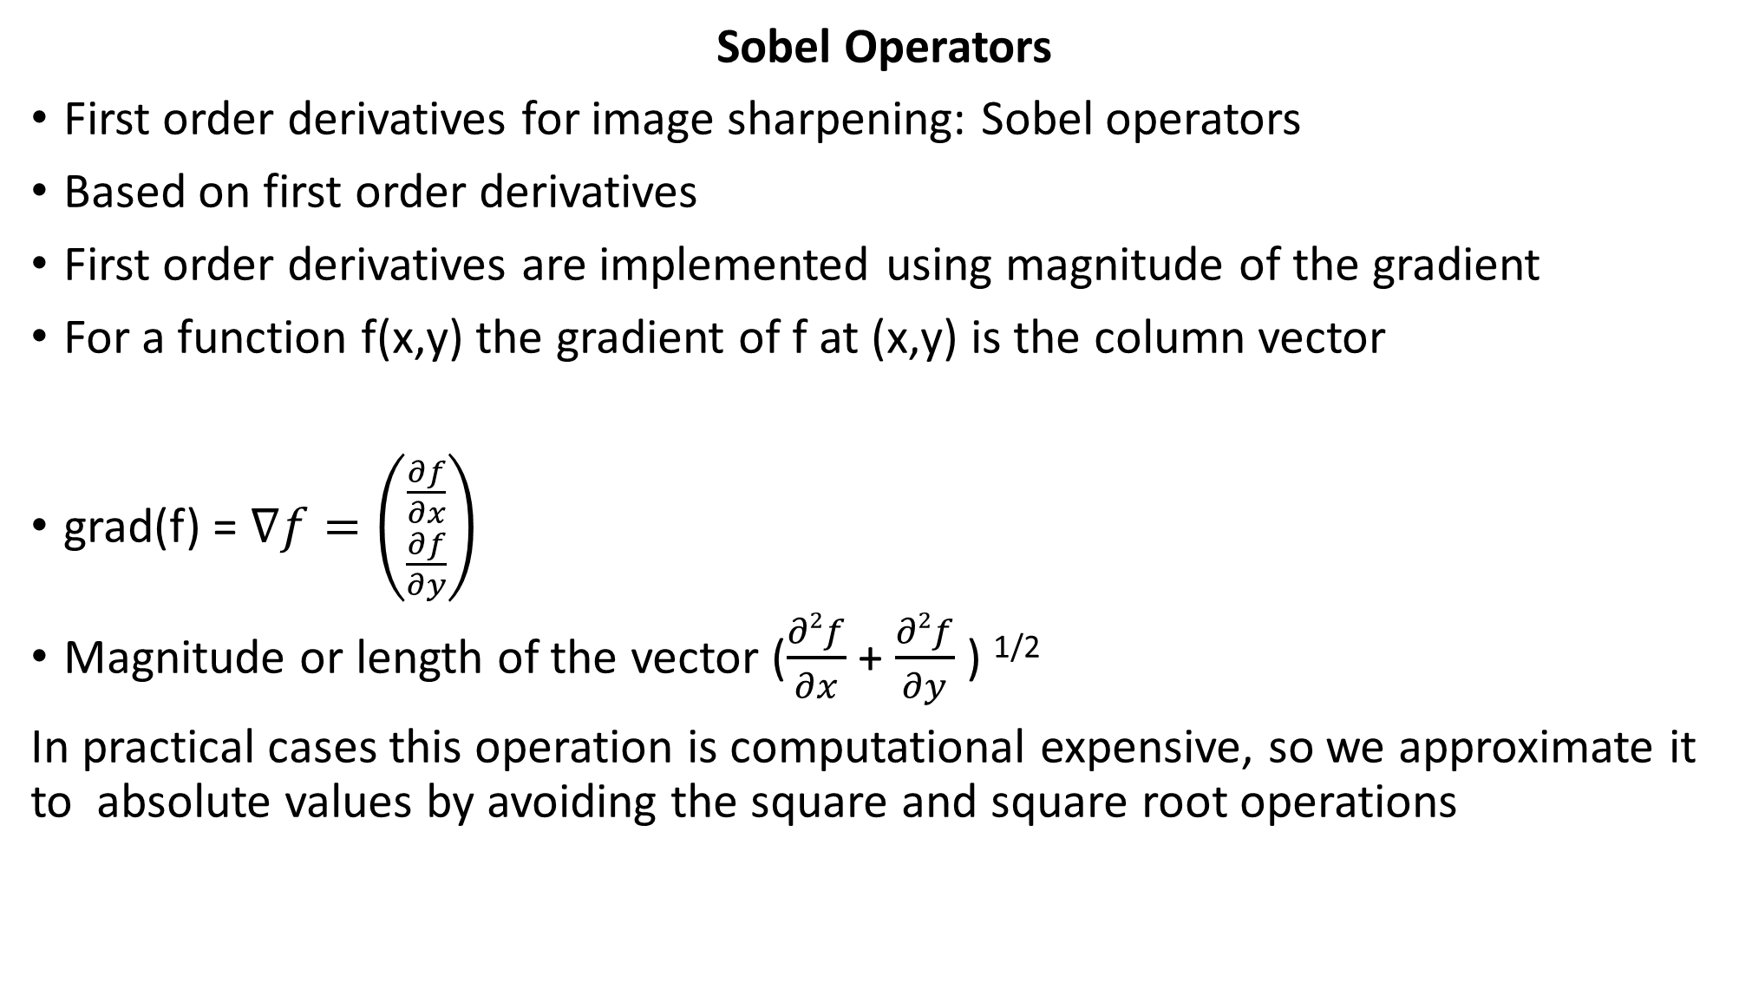
Sobel Operators
First order derivatives for image sharpening: Sobel operators
Based on first order derivatives
First order derivatives are implemented using magnitude of the gradient
For a function f(x,y) the gradient of f at (x,y) is the column vector
grad(f) = $∇f=\left({\frac{∂f}{∂x} \atop \frac{∂f}{∂y}}\right)$
Magnitude or length of the vector ($\frac{∂2f}{∂x}$ + $\frac{∂2f}{∂y}$ ) ^{1/2}
In practical cases this operation is computational expensive, so we approximate it to absolute values by avoiding the square and square root operations

Slide 35

mag($∇f)= \left|\frac{∂f}{∂x}\right|+\left|\frac{∂f}{∂y}\right|$
Gx $=\frac{∂f}{∂x}$ = [f(x+1,y-1)+f(x+1,y+1)+2f(x+1,y)]-
[f(x-1,y-1)+f(x-1,y+1)+2f(x-1,y)]
Gy$=\frac{∂f}{∂y}$ = [f(x-1,y+1)+f(x+1,y+1)+2f(x, y+1)]-
[f(x-1,y-1)+f(x+1,y-1)+2f(x,y-1)]
f (x-1, y-1) | f (x-1, y) | f (x-1, y+1)
f (x, y-1) | f (x, y) | f (x, y+1)
f (x+1, y-1) | f (x+1, y) | f (x+1, y+1)
-1 | -2 | -1
0 | 0 | 0
1 | 2 | 1
-1 | 0 | 1
-2 | 0 | 2
-1 | 0 | 1
Sobel operators are used for edge detection

Slide 36
Compute Gx and Gy, gradients of the image performing the convolution of Sobel kernels with the image. Use zero-padding to extend the image
0 | 0 | 10 | 10 | 10
0 | 0 | 10 | 10 | 10
0 | 0 | 10 | 10 | 10
0 | 0 | 10 | 10 | 10
0 | 0 | 10 | 10 | 10

